Slide 1
GJK
Support Function
Game 256

Slide 2
Overview
Support Points
Support Function
Visualisation
Building a Simplex

Slide 3
Support Points
The farthest point in a given direction on a shape.

Slide 4
Support Points
At its most intuitive:
  Iterate across all vertices in mesh.
  Find the farthest point in a given direction (dot product.)
  Return that point.

Slide 5
Support Function
Using support points generate the necessary Minkowski Sum support point.

Slide 6
Support Function
At its most intuitive:
  Get the support point from mesh A, along direction d.
  Get the support point from mesh B, along direction –d.
  A + -B.

Slide 7
Visualisation
Lets take a look at how a tetrahedron is built.

Slide 8
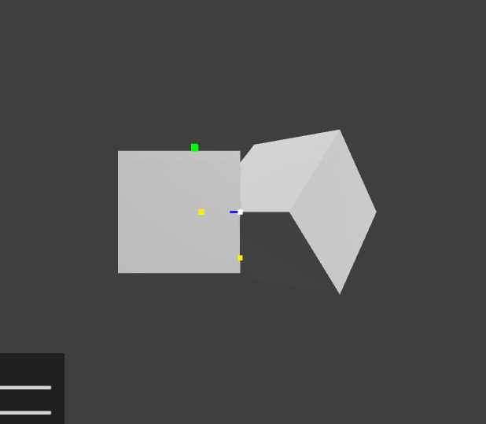
Visualisation
Yellow points are support points on each mesh.
Green points are support points on Minkowski Sum.
Blue line is direction of search.

Slide 9
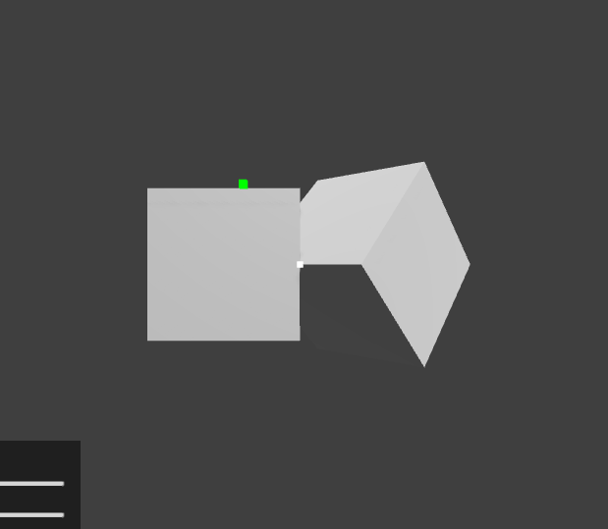
Visualisation
From the direction and the support point on the Minkowski Sum we get the first vertex of the simplex.
We now have a point simplex.

Slide 10
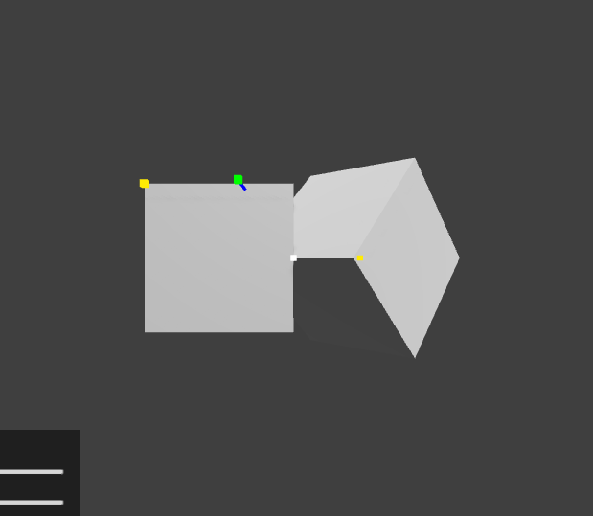
Visualisation
Yellow points are the new support points given the new search direction (blue line.)

Slide 11
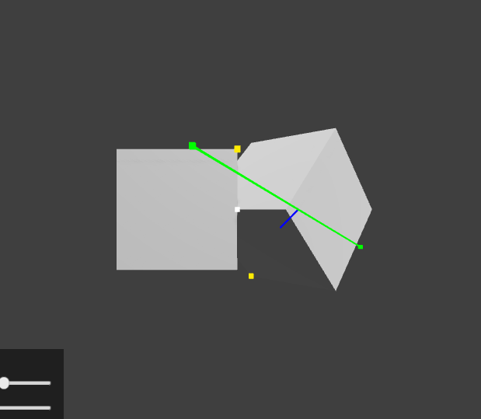
Visualisation
Using the support points from the previous slide, we can add the new green point to the simplex.
We now have a simplex line.
As well given the blue line, and the yellow support points we know where to look next.

Slide 12
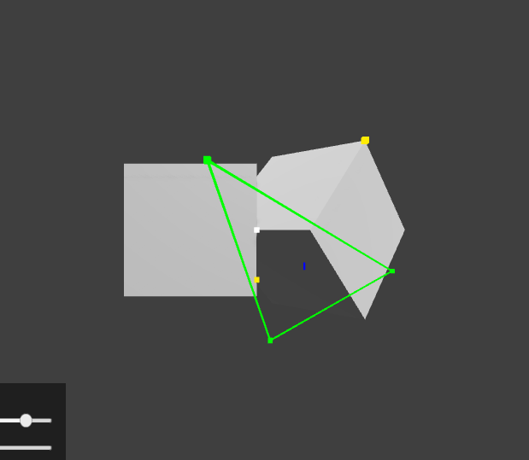
Visualisation
Again, using the support points from the last slide, we can add the next point to the simplex.
We now have a triangle simplex.
We also have 2 new support points and a new direction to search.

Slide 13
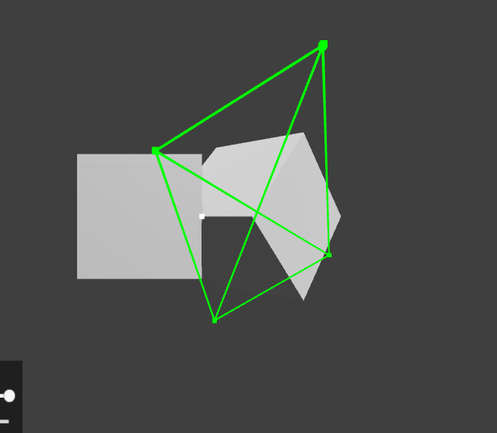
Visualisation
From those support points we can again add it to the simplex.
We now have a tetrahedron simplex.
Next we can check for origin overlap.

Slide 14
Building a Simplex
From point to line to triangle to tetrahedron.

Slide 15
Steps
Decide on a direction.
Find a support point.
Add it to the simplex.
Iterate:
  Find a support point.
  Add it to the simplex.
  Process the simplex.

Slide 16
Step 1
Pick a direction
Pick a starting search direction, this can have quite an effect on how many iterations are necessary to find an origin overlap.

Slide 17
Step 2
Find a Support Point
Using A+-B and our support function for meshes, generate our first support point on the Minkowski Sum.

Slide 18
Step 3
Generate the Simplex
Add the first support point the simplex.
We now have a point simplex.

Slide 19
Step 4.1
Find a Support Point
Now that we are inside the loop, the process becomes adding the next support point given the direction last determined.

Slide 20
Step 4.2
Add it to the Simplex
Given the direction determined either last iteration, or at start up, add the support point from the Minkowski Sum to the Simplex.
At the first iteration, we now have a line simplex.

Slide 21
Step 4.3
Process the Simplex

Slide 22
Process the Simplex
This can go 1 of 3 ways:
  Process a line.
  Process a triangle.
  Process a tetrahedron.

Slide 23
Process a Line
If we have a line, all we need to do is determine what direction to search for the next point, in order to make a triangle.

Slide 24
Process a Line
A
B
O
If A is the newest point we added
B is the other point.
O is the origin.
We are looking for the direction perpendicular to AB in the direction of the origin.

Slide 25
Process a Triangle
B
C
O
A
Now A is the newest point.
B is the last new point.
C is the other point.
We are looking for the face normal of the triangle, in the direction of the origin.

Slide 26
Process a Tetrahedron
C
D
B
O
A
Now what direction do we search?

Slide 27
Process a Tetrahedron
C
D
B
O
A
The answer isn’t so simple.
We can’t have a simplex with 5 points, so we need to check if the origin is inside the tetrahedron, and if it isn’t we need to “trim” the simplex, removing the points farthest from the origin.

Slide 28
Process a Tetrahedron
C
D
B
O
A
The easiest way to do this is to check each of the new triangles we made when we added A to the simplex.
We want to check if their face normal (pointing away from the inside of the tetrahedron) is pointing in the direction of the origin. If it is, then we can remove the point not on that face.

Slide 29
Process a Tetrahedron
C
D
B
O
A
In the above case we would start by checking ABC, given the face normal (blue arrow.)
Since it is pointing towards the origin, and away from the tetrahedron (the origin is outside the tetrahedron) we know we can throw away D, and look in the direction of the face normal.

Slide 30
Process a Tetrahedron
C
B
O
A
And so we would generate a new tetrahedron, from a new triangle.

Slide 31
Up Next
Checking for Origin Overlap.

Slide 32
Fin

